Slide 1

Leila Marvian
PhD in Ststistics
Introduction ADTSA package in R

Slide 2
The Autocorrelation Function (ACF) stands as a linchpin
in time series analysis and forecasting. In this event, we
emphasize the pivotal role played by ACF, especially
in the context of parametric approaches, where it
serves as the compass guiding analysts through intricate
data patterns. Our study explores the distribution of ACF, both theoretically and empirically, showcasing its status as the bedrock of time series analysis .

Slide 3
The study demonstrates that the sample ACF deviates
from normality after a certain lag, with longer time series
lengths exhibiting more pronounced departures.
This challenges the assumption of normality in time series
modeling .

Slide 4



1)
2)

Slide 5
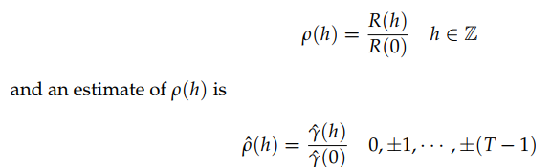
The autocorrelation function, ACF, is given by

Slide 6




Distribution of ACF
For a stationary white noise process, it has been
demonstrated that as the sample size, denoted as T,
becomes sufficiently large, the estimated autocorrelation
function approximately conforms to a normal
distribution with a mean of and variance of
Bartlett’s approximation

Slide 7


Slide 8
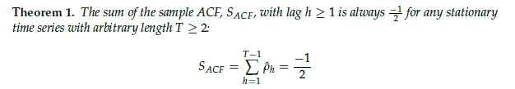

Slide 9
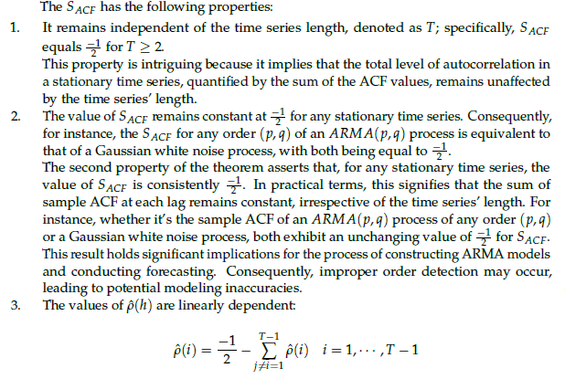

Slide 10
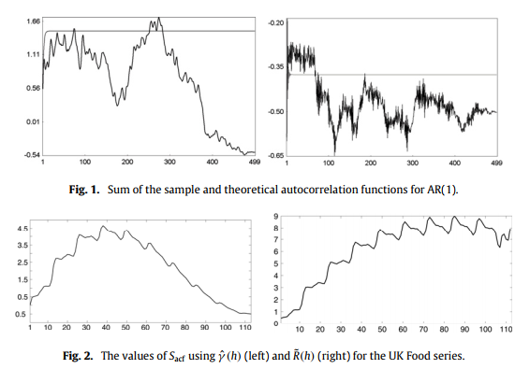

Slide 11
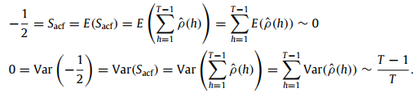

Slide 12
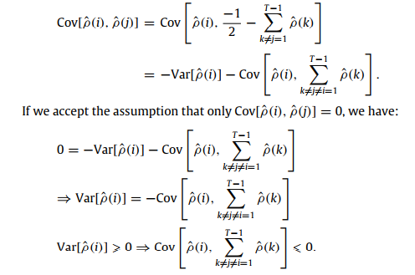

Slide 13
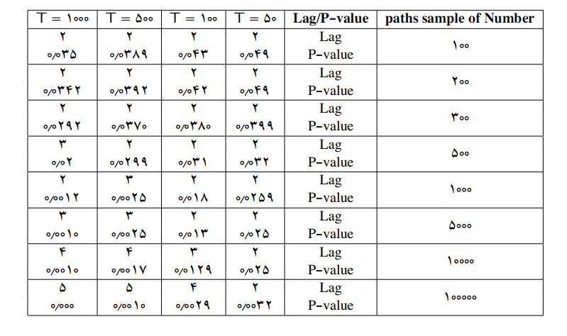

Slide 14
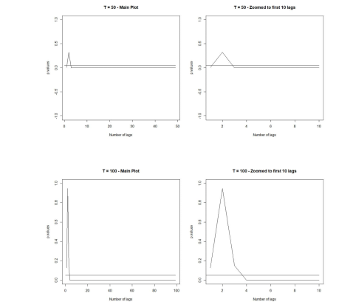

Slide 15
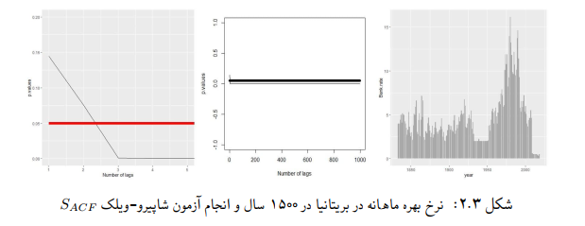

Slide 16
THANK YOU
Contact with us:
Email address: urmia@rladies.org
LinkedIn: R-Ladies Urmia
Twitter: @RladiesUrmia
Meetup: https://www.meetup.com/rladies-Urmia/

